Slide 1
Retrospective Review Process
Heather Brady, LPC
Director, Clinical Operations
Optum Alaska
May 11, 2023
Notes:
Introduction Good morning, name, title.
Repeat from prior sessions with additions and modifications from questions and feedback
PHE update: Currently set to end 07/14/22 which means SFY limits will re-set and SA’s will begin. We do not have official information as to any changes.

Slide 2
Clinical Retrospective Review
Retrospective (retro) review is a request for a review of services that have already been delivered and a service authorization has not previously been submitted for clinical review.
Retrospective reviews may be submitted if a provider was approved by the state to retrospectively cover the time of the service and/or if the participant had Medicaid eligibility retroactively approved to cover dates of service.
Retrospective reviews may be submitted if the provider has received a deny due to no authorization notice (DNA) and the participant is no longer receiving treatment services.
Optum must receive retro review requests in writing via fax or mail.
Notes:
ASAM is the only required LOCG to be used (SUD providers), the rest are what OPTUM will use in determining medical necessity
LOCGs are independently determined by professional organizations, not created by Optum
Evidence based
Review LOCGs on slide
Important to utilize the tool based on age and if there is SUD

Slide 3
Clinical Retrospective Review
For a request to be considered a Retrospective Review, there are certain requirements that must be met:
No previous approvals can be issued for the episode of care (treatment type, treating provider, and dates of service) identified in the request.
Provider receives a Deny due to No Authorization (DNA), and the participant is no longer receiving treatment services.
The request must be received within 365 days after the last date of service.
The request must be received after the participant has ended or has been discharged from the service.
If a participant is still receiving services, submit a service authorization form, not a retrospective review request.

Slide 4
Required Documentation for a Retrospective Review
Complete an Optum Alaska retro-review cover sheet. The cover sheet MUST be completed and submitted with all retro-review requests. The cover sheet is located on the provider website at: Alaska.optum.com. Please see below:
Once on the site select the “For Alaska Medicaid Providers” tab at the top in the grey
Once the drop down opens you will then click “service authorizations”
At the bottom of the page, under “Appeals Form” you will find the Retrospective Cover Sheet
Please include any supporting documentation considered relevant (e.g., admission/intake assessment, biopsychosocial, treatment plan, medical necessity tool etc.)
A review of the process as well as all required documents are listed on the Retrospective Review Information and Instruction Sheet located on the provider website at: Alaska.optum.com
Notes:
DETAILS DETAILS DETAILS!!!
Paint the picture for the CA. If you were reviewing a SA, what would you need to know?

Slide 5
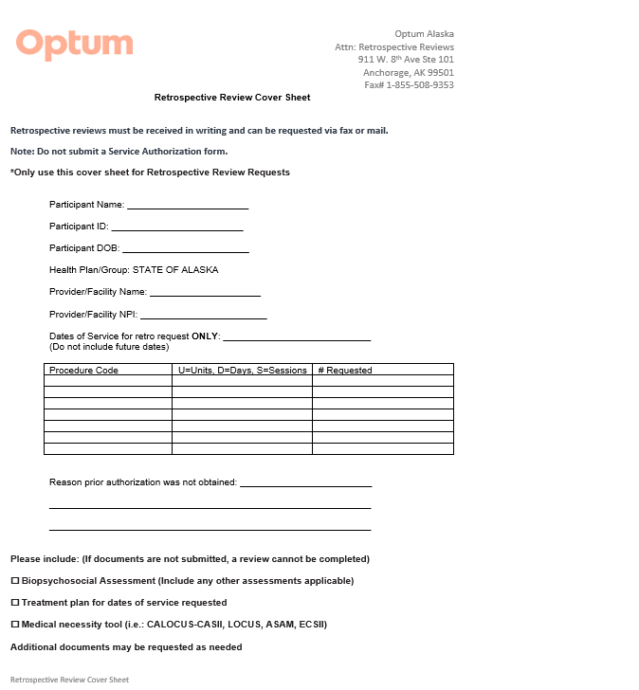
Clinical Retrospective Review Cover Sheet

Slide 6
How to Submit a Retrospective Review Request to Optum
There are two options to submit a retrospective review:
You may fax the request to the following number: 855.508.9353 OR
Mail the request to the following address:
Optum Alaska Attn: Retrospective Reviews
911 W 8th Avenue, Suite 101, Anchorage, AK 99501

Slide 7
Clinical Retrospective Review Determination
Optum will notify providers in writing of the retrospective review decision within 30 days of receipt of the retro-review submission.
If the reviewer upholds the initial decision, providers have the right to file a second level appeal.

Slide 8
Retrospective Review Important Notes
Retrospective Reviews do not replace service authorization requests.
Retro reviews may be submitted if a provider was approved by the state to retrospectively cover the time of the service and/or if the participant had Medicaid eligibility retroactively approved to cover dates of service.
For a request to be considered a retrospective review, there are certain requirements that must be met:
The request must be received AFTER the participant has ENDED or has been DISCHARGED from the service (this is different from Service Authorizations as the participant is still actively enrolled in services)
No previous approvals can be issued for the episode of care identified in the request
Provider receives a DNA, and the participant is no longer receiving treatment services.
The request must be received within 365 days after the last date of service.
Providers submit a retrospective request using the Retrospective Review Cover Sheet located at Alaska.optum.com, For Alaska Medicaid Providers, Service Authorizations, under Appeals.
Do not submit a service authorization form.

